Slide 1
TechDeals
Course Code | CSE 278
Hand in Date | 16 JULY, 2023
Project Supervisor | Presented By
Dr. Saleh Ahmed, Associate Professor, Department of CSE, BSMRSTU | Md. Rakibul Haque ID: 18ICTCSE001

Slide 2
Introduction

Slide 3
TechDeals is an app for finding the best tech deals
A cutting edge price comparison app
Provides real-time price information from a wide range of online retailers
Simplify your tech shopping experience.

Slide 4
Features

Slide 5
Comprehensive Search
Real-time Price Comparison
Detailed Product Insights
User Friendly Interface
Save Time and Money

Slide 6
User Interface

Slide 7
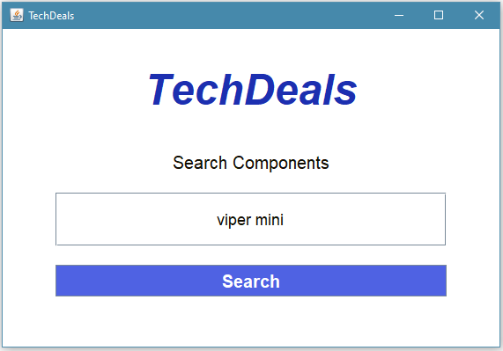

Slide 8
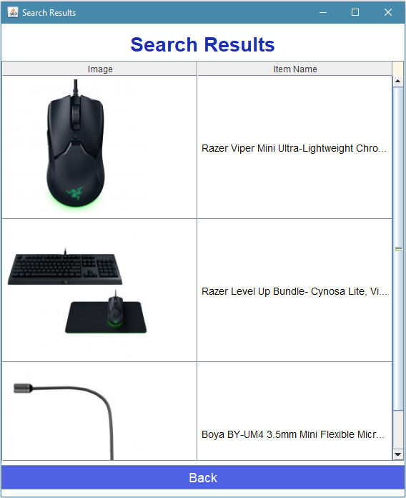

Slide 9
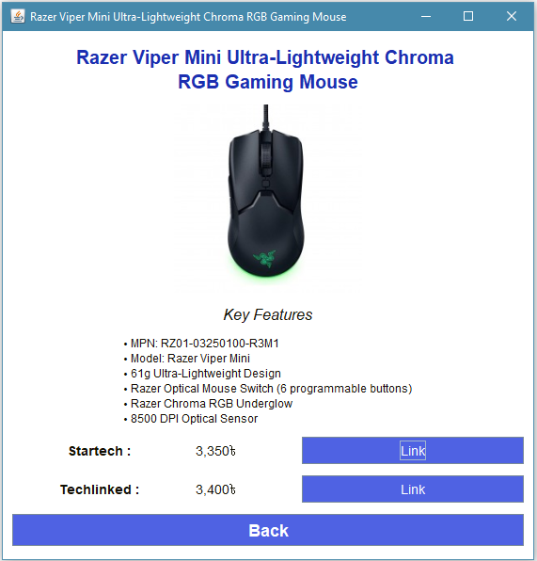

Slide 10
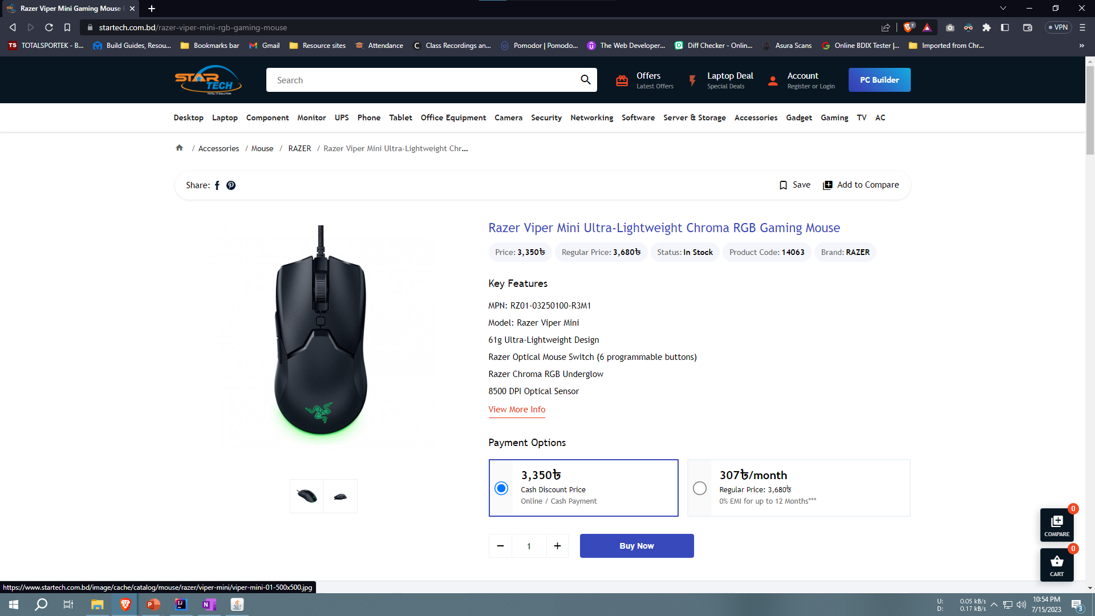
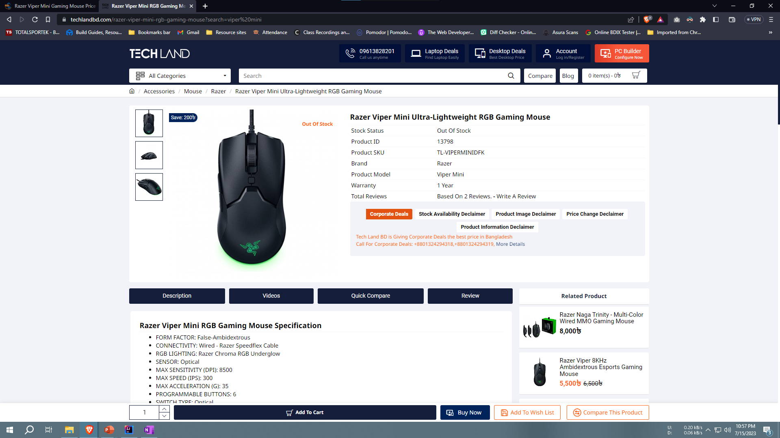

Slide 11
How It Works

Slide 12
Technologies Used
Java
Swing UI designer
Jsoup
TwelveMonkeys
IntelliJ IDEA

Slide 13
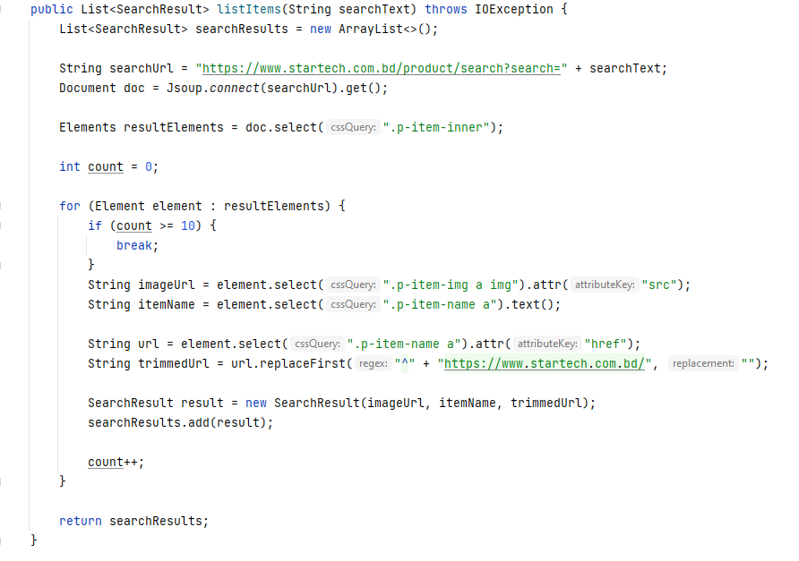

Slide 14
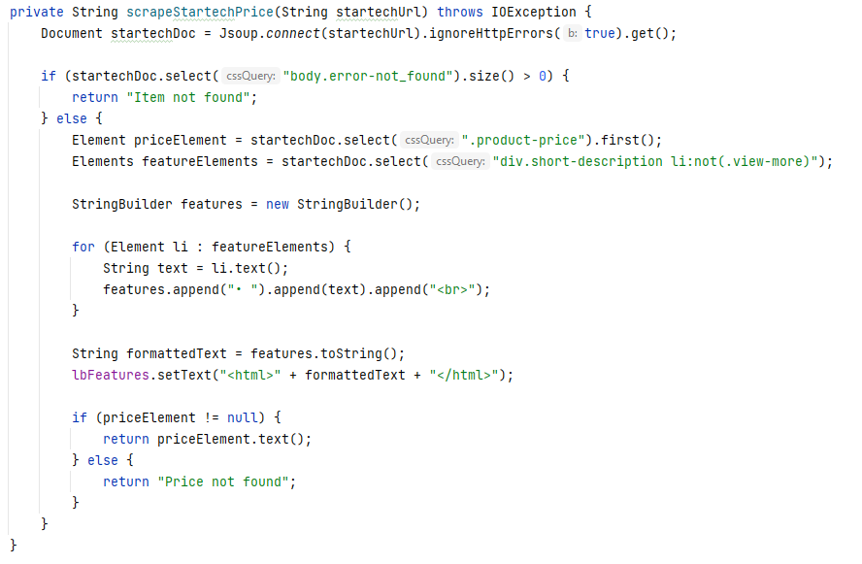

Slide 15
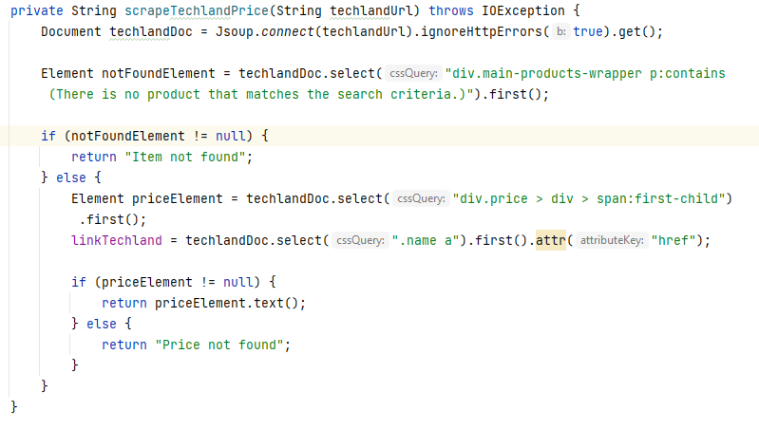

Slide 16
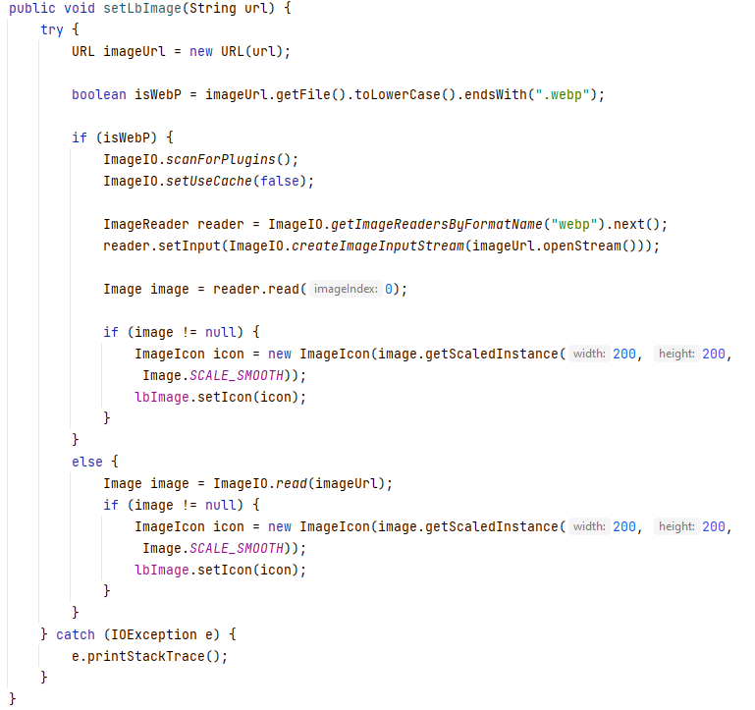

Slide 17
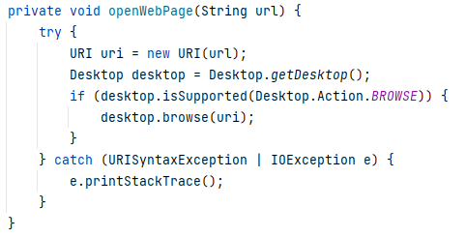

Slide 18
Future Improvements

Slide 19
Enhanced Search Functionality
Improved User Interface
More Websites to Compare Price With
User Accounts and Wishlist
Enhanced Security

Slide 20
Conclusion

Slide 21
TechDeals, the ultimate tech price comparison app, enables you to make informed decisions and save money on your tech purchases
Start using TechDeals Today!

Slide 22
Thank You

